Slide 1

Predicting multiple molecular properties
for identification of new drug molecules using
Datamining techniques
ACKNOWLEDGEMENT:
I WOULD LIKE TO THANK DR. SHOUYI WANG AND TEACHING ASSISTANT,
LINH HO MANH FOR THEIR CONSTANT SUPPORT AND GUIDANCE.
Presented by – Ankit Ranjan

Slide 2
INTRODUCTION
Biological molecules (like proteins) play a vital role in the chemical processes essential for life as they are existing all in living beings.
Most genetic diseases are a kind of genetic mutation of the original protein molecule that it replaces.
Thus, it is important to learn from the existing molecules to predict any possible mutations, and check if they it is a dangerous or viable compound based on certain properties. Further, scientists can be ahead of the curve by generating possible compounds from a set of desired chemical properties.

Slide 3
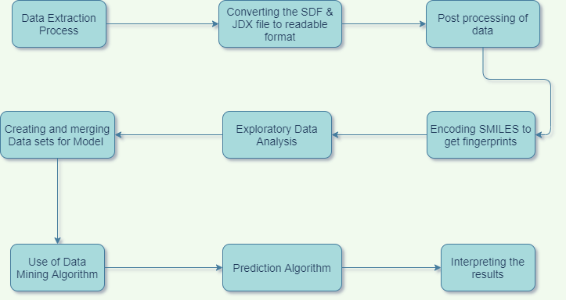
FLOW CHART

Slide 4
DATA EXTRACTION AND DATA PROCESSING
Compounds are stored in the form of canonical SMILES which are unique for every compound.
SMILES stands for simplified molecular-input line-entry system.
Fingerprints of chemical compounds is the encoded form of canonical SMILES. It can be as input that can be understood by a Machine Learning model.
A “fingerprint” is a bit vector (binary) that represents properties of a compound. These are unique for most compounds.
Molecular Properties of compounds can be determined from the encoded fingerprints as the input.

Slide 5
Rdkit toolbox
In Bioinformatics, RDkit is a popular tool for working with chemical compounds on a large scale. It can be to process different compounds and their molecular properties, which are crucial to drug likeness.
It has been used in this project to obtain the SMILES from the SDF files and consequently the Chemical Fingerprints.
The properties that are being predicted in this project are: Molecular weight, lipophilicity, TPSA.

Slide 6
Input and output parameters
Parameter Name | Unit | Description
Setting/Input Parameters:
Fingerprints | Bit vector | It is a vector that represents a property of a chemical compound.
Output Parameters:
Exact Molecular weight | Mols | The molecular weight of the compound in mols
Lipophilicity | LogP | LogP, this is the partition coefficient of a molecule between an aqueous and lipophilic phase, usually octanol and water.
Topological Polar Surface Area | Å² | The surface sum over all polar atoms or molecules, primarily oxygen and nitrogen, also including their attached hydrogen atoms.

Slide 7
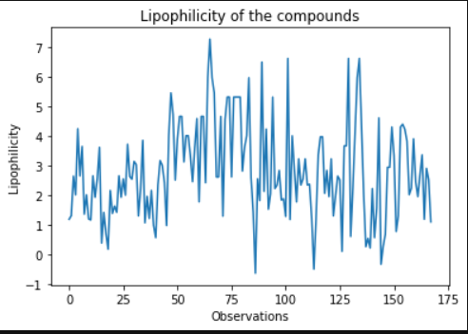
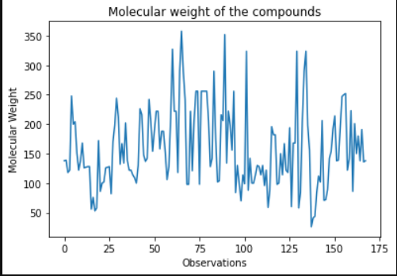
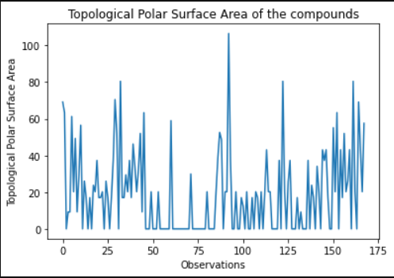
DATA EXPLORATION

Slide 8
MACHINE LEARNING MODELS IMPLEMENTED
LINEAR REGRESSION FOR MULTI OUTPUT
KNN FOR REGRESSION
RANDOM FOREST REGRESSION
GRADIENT BOOSTING FOR MULTI OUTPUT

Slide 9


Slide 10
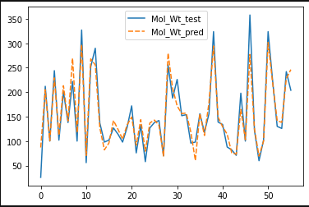
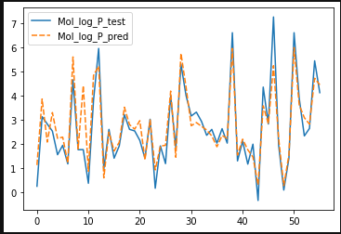
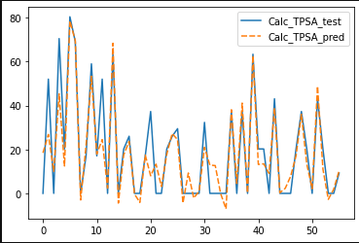
LINEAR REGRESSION

Slide 11
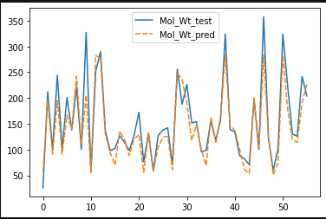
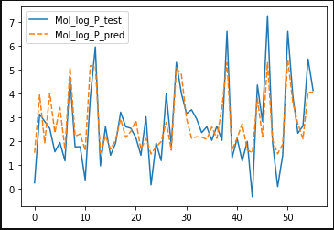
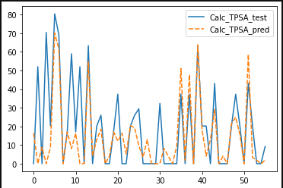
KNN REGRESSOR

Slide 12
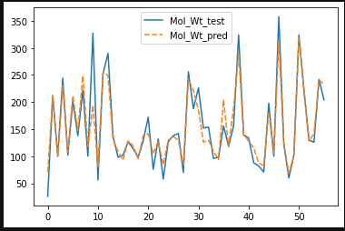
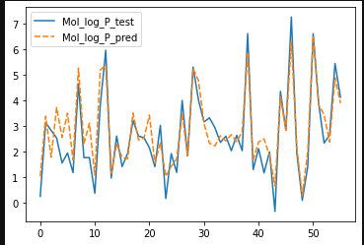
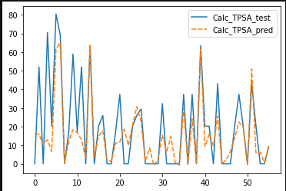
GRADIENT BOOSTING

Slide 13
REGRESSION METRICS MEASURES
R2 SCORE
ADJUSTED R SQUARED
ROOT MEAN SQUARED ERROR
MEAN ABSOLUTE ERROR

Slide 14
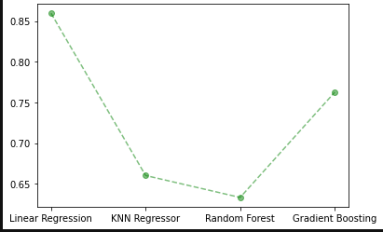
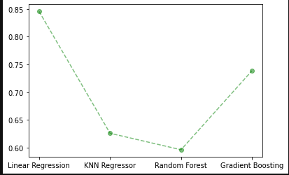
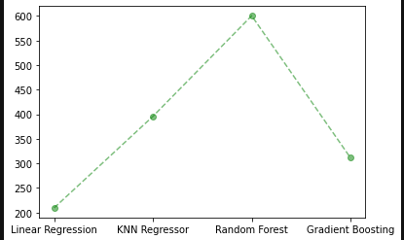
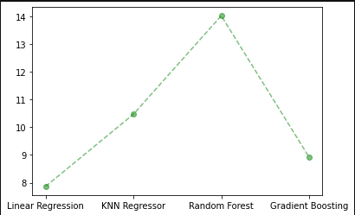
METRIC ANALYSIS
R2 score
Adjusted R2
MAE
RMSE

Slide 15
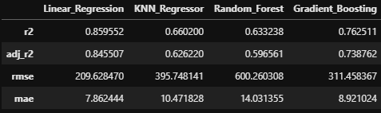
METRIC ANALYSIS

Slide 16
Conclusion and Future Work:
Drug discovery is an extremely challenging but crucial field for the future of the survival of our species. Linear Regression followed by Gradient Boosting gave promising results (for the used metrics R-2, Adjusted R-2, RMSE and MAE). However, the simpler model i.e., Linear Regression is the better choice to run for a larger dataset of thousands of molecules, given that some processors may have issues with Gradient Boosting with large number of components.
The next step would be to have the computational capacity to add more molecules for training. Beyond this project, there are many other important properties to predict that aid drug discovery based on their proximity with existing molecules. They include but are not limited to electron ionized mass spectra, solubility, the number of H-bond donors for a molecule, and the number of H-bond acceptors for a molecule.

Slide 17


